Slide 1
The AI Journey: From Models to Agents at Work
Dennes Torres

Slide 2
About This Session
Keep you phone in hand to take pictures of QR Codes
Take notes of the questions to ask at the end
Embrace the Journey
Most Images were AI generated

Slide 3


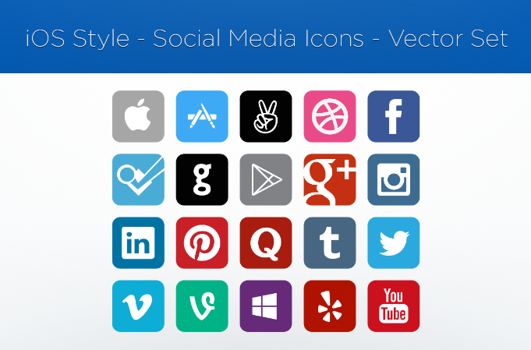




Dennes Torres Data Platform MVP (Alumni)
Dtower Software
https://dtowersoftware.com
Trainer
MCT, Azure Solutions Architect, Azure Data Engineer and Azure DevOps Engineer
Malta Data Platform UG Leader
Malta
MMDPUG
https://www.facebook.com/MMDPUG
http://dennestorres.com
Dennes.Torres
@Dennes
https://br.linkedin.com/in/dennestorres
dennes@bufaloinfo.com.br
http://youtube.com/c/dennestorres

Slide 4
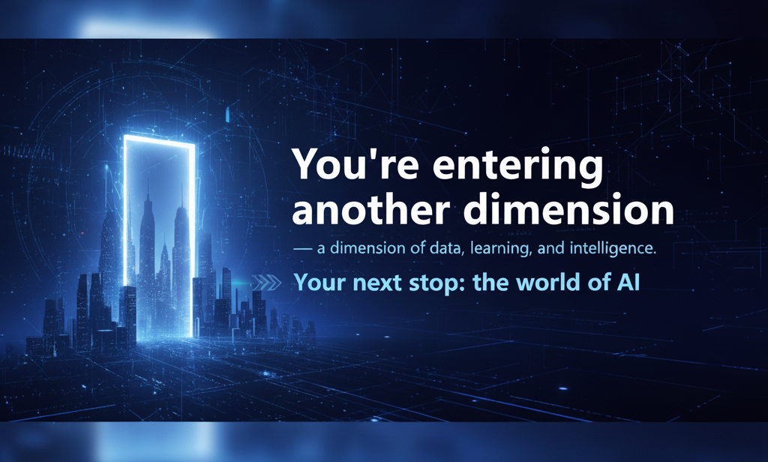

Slide 5
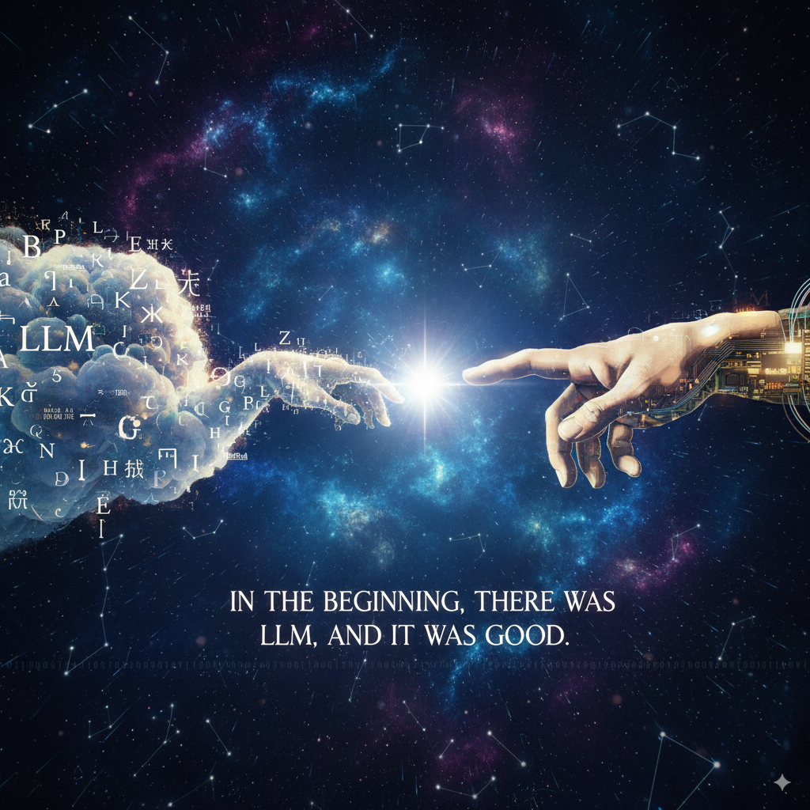
Notes:
In the beginning, there was LLM, and it was good

Slide 6
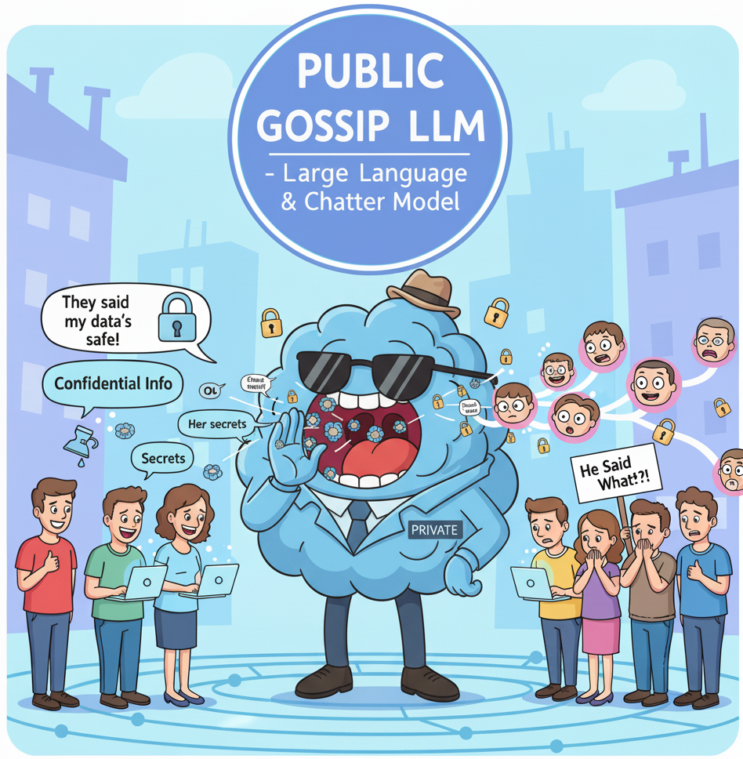

Slide 7
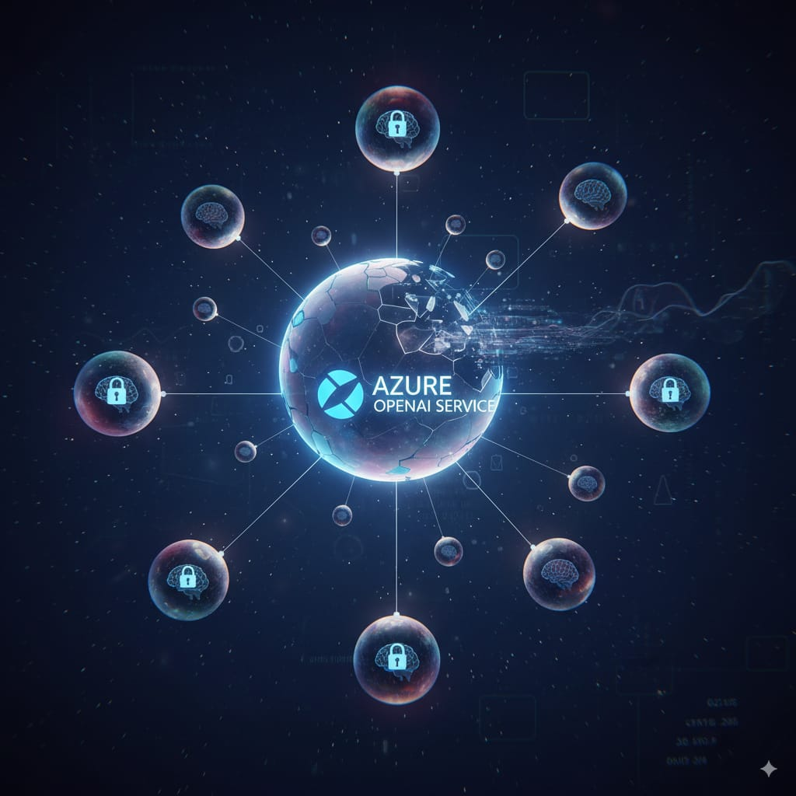
Notes:
We learned how to make LLM private – each one has your own

Slide 8
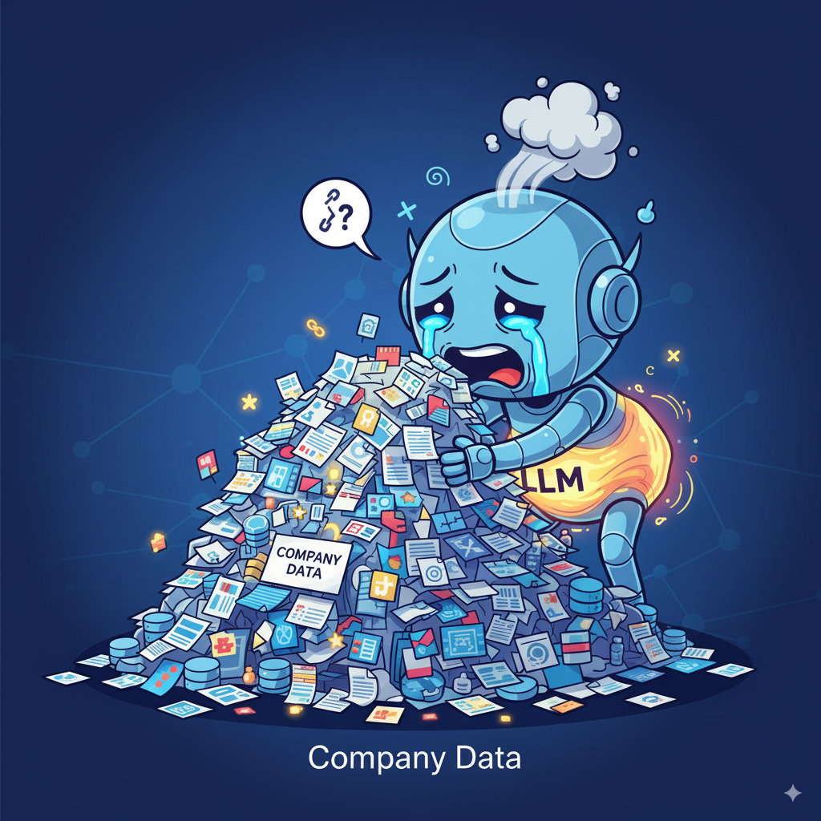
Notes:
But LLM can’t ingest and process all the company data

Slide 9
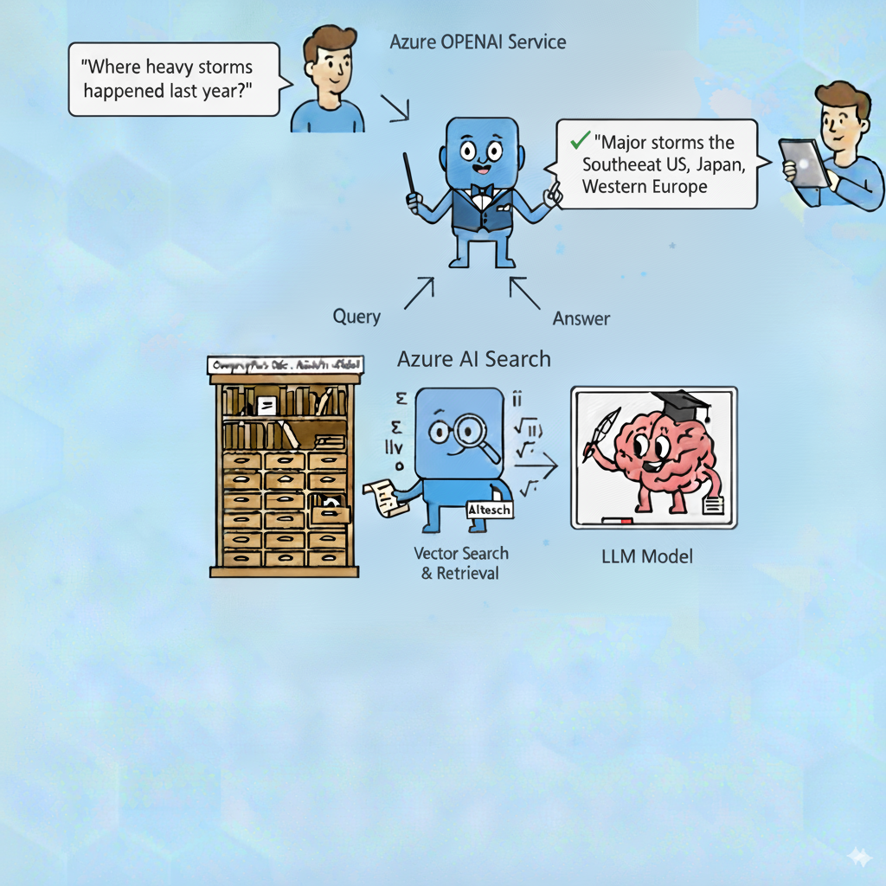
Notes:
We need to search the relevant data for LLM – but it can’t be a simple search, it needs to be a powerful, semantic search – comes the vector search into place

Slide 10
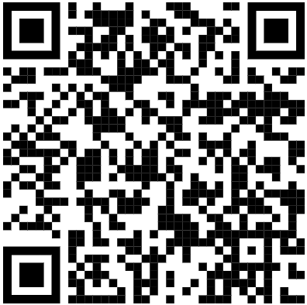
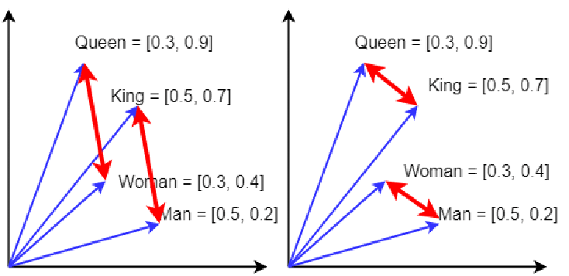
Notes:
Words are transformed in numbers mathematically representing their meaning – This mathematical core makes the LLM powerful

Slide 11
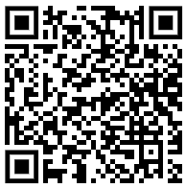




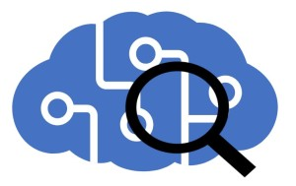



Azure Document Intelligence
Embedding Model
AI Search
Open AI RAG
Trigger + Document
Index Search
Data + Embeddings
Question
Backend
Frontend
Notes:
RAG comes into play – an architecture to use LLM over our private data with accelerators which allow us to put everything in place in 10 minutes

Slide 12
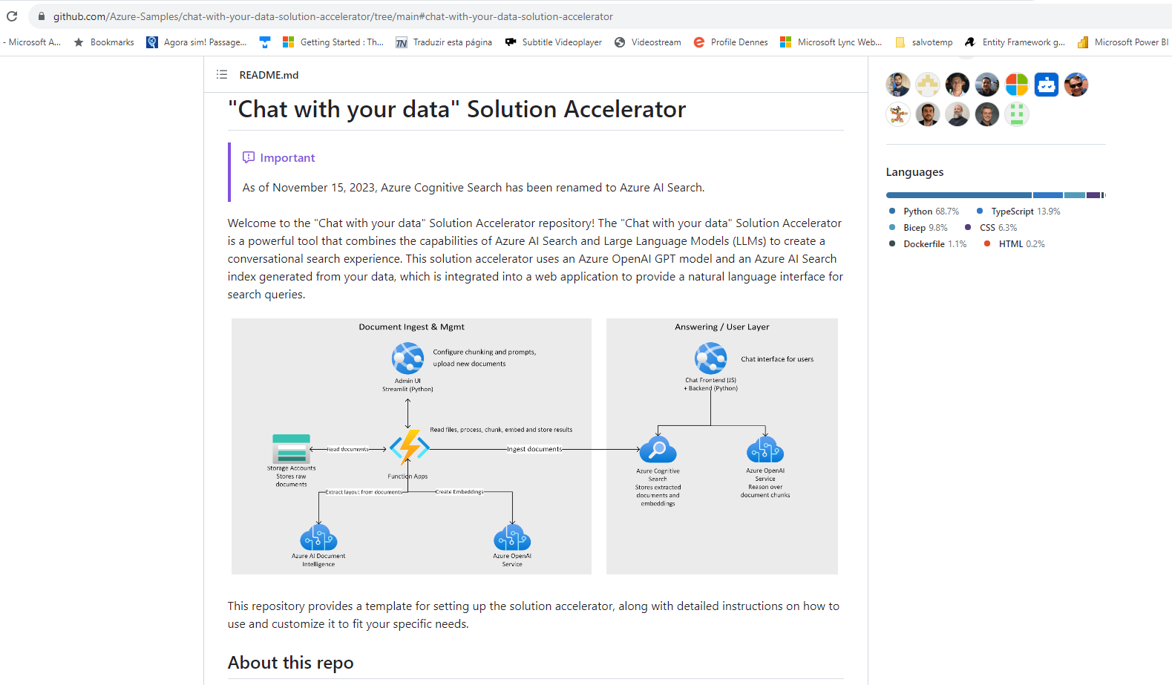
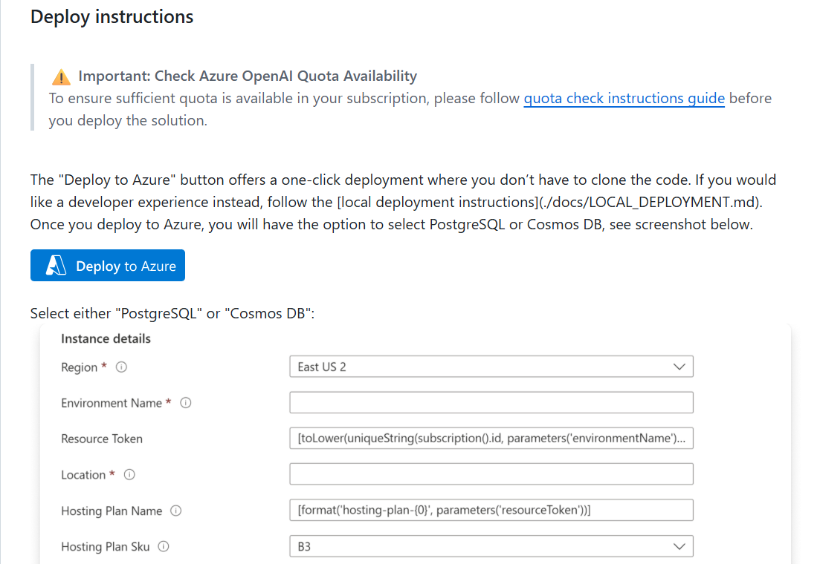
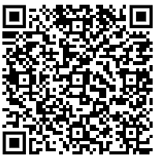

Slide 13
RAG Demo

Slide 14
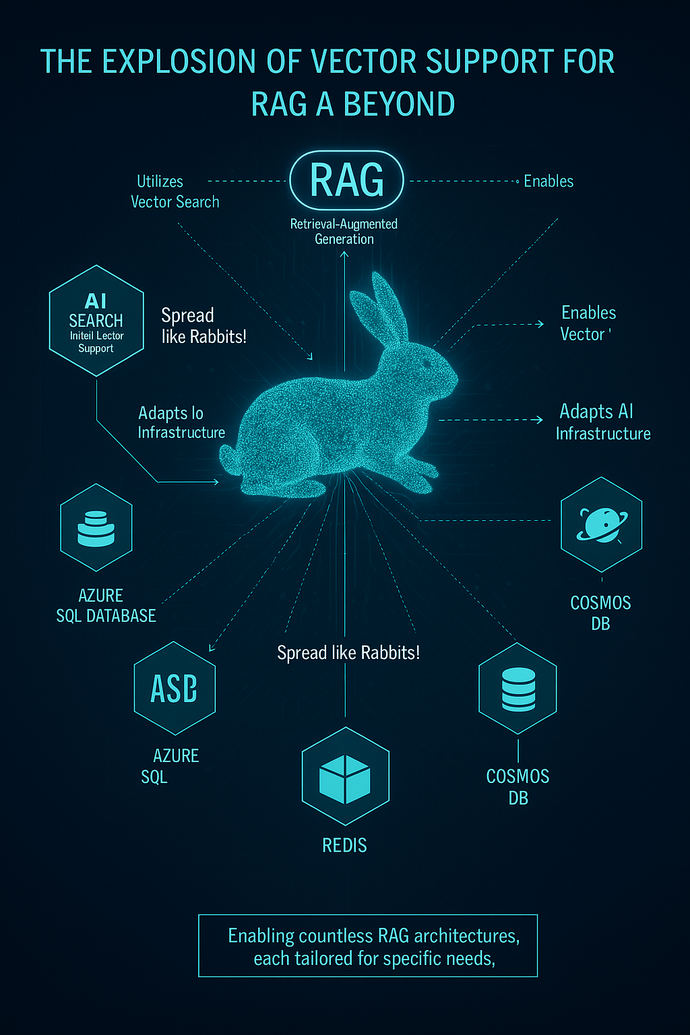

Slide 15
Vector Support

Slide 16
RAG is for unstructured data. Structure data works better with NLP – Natural Language Processing

Slide 17
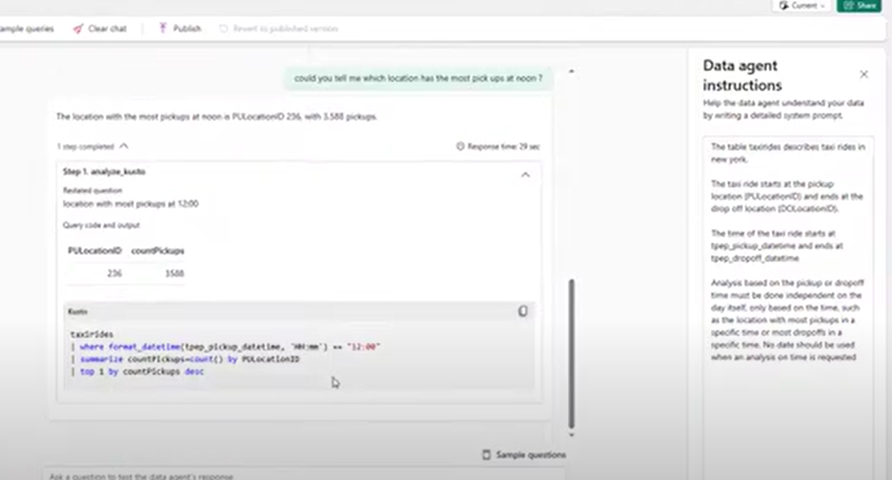
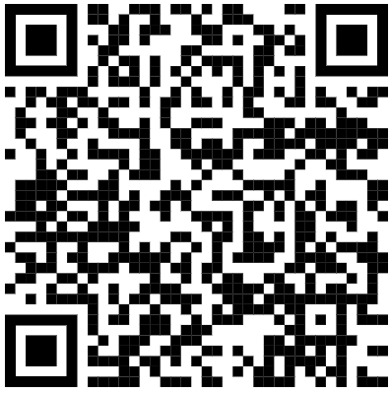
Microsoft Fabric Data Agent

Slide 18
RAG/NLP solutions reproduce like rabbits

Slide 19
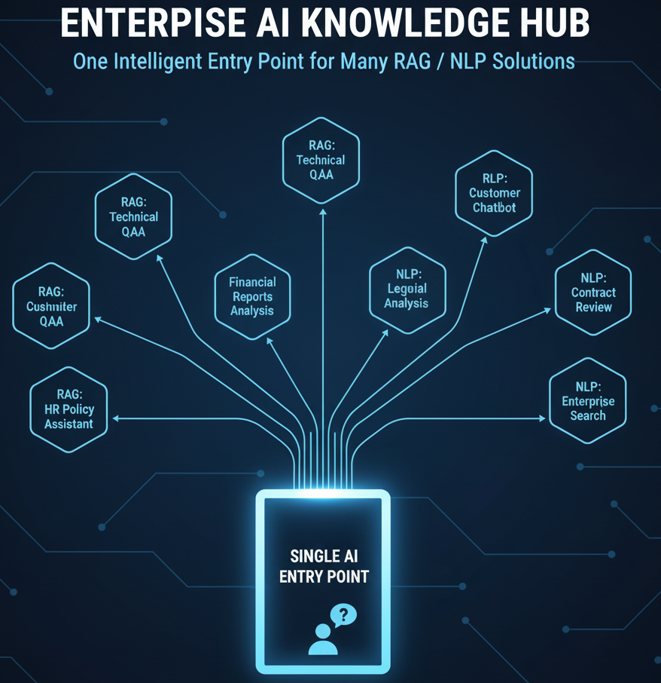

Slide 20
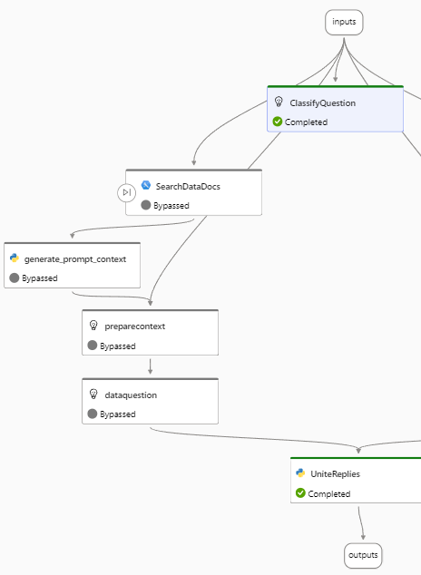
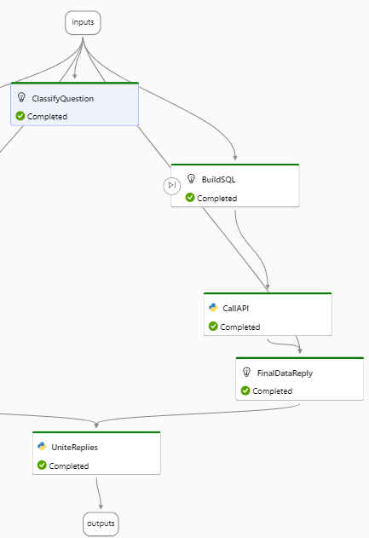
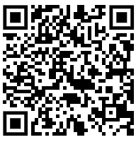
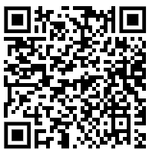

Slide 21
What if LLMs can take actions?

Slide 22
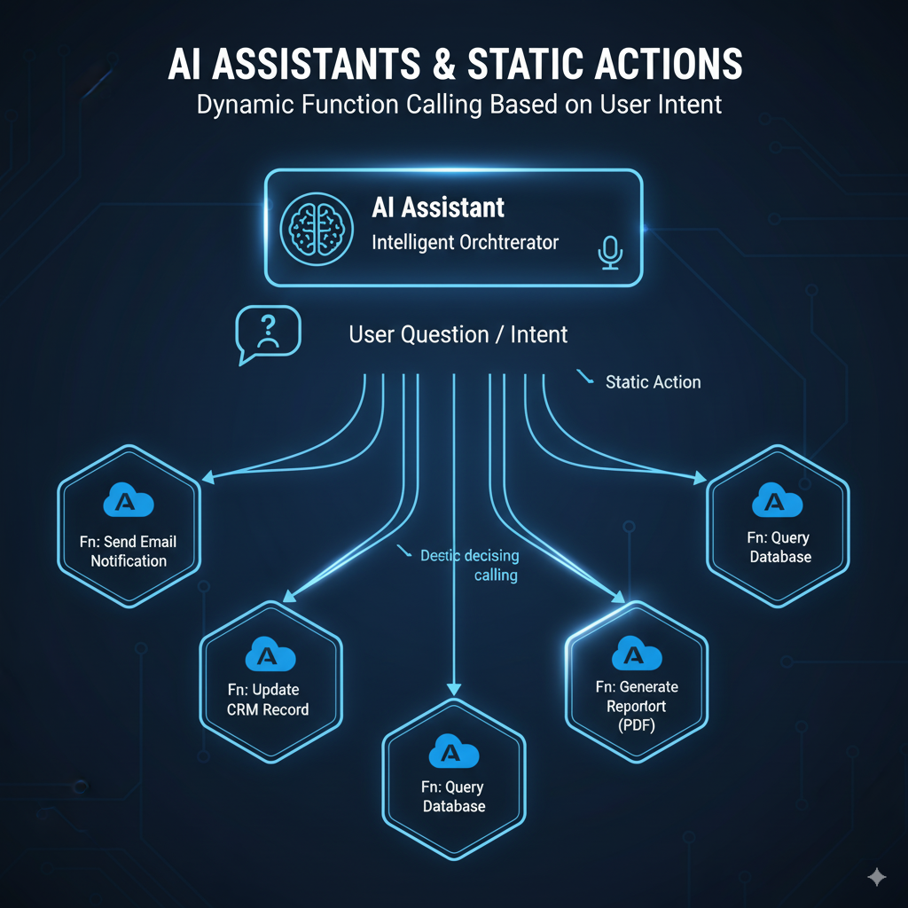
Notes:
Assistants can be linked to actions and can take actions when requested

Slide 23
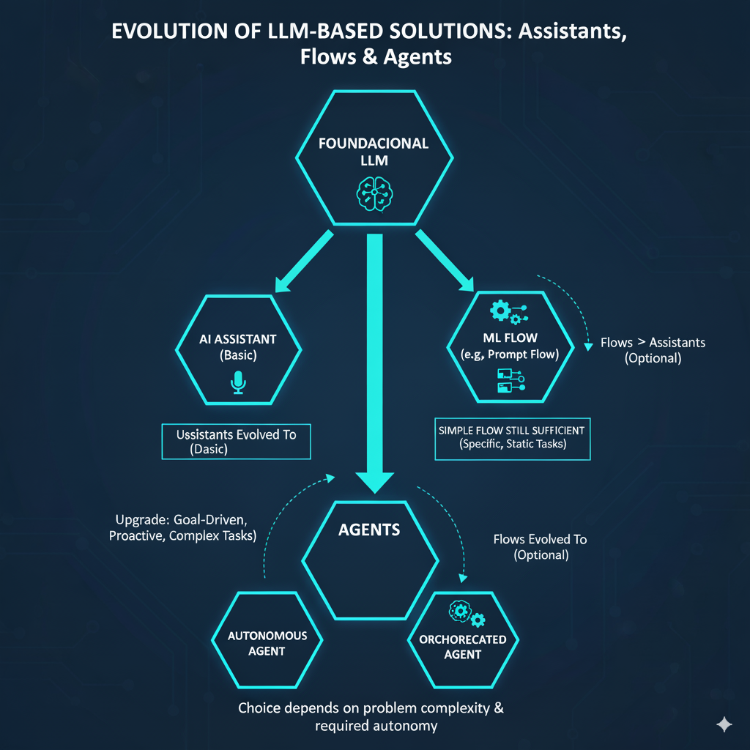
Notes:
The evolution was ramified: LLMs evolved in parallel to flows and to assistants Assistants may have the capability to replace flows,

Slide 24
Assistants and Beyond
Assistants were quickly replaced
The new Fashion: Agents
They are assistants with a new name, because they do the same
They are an upgrade, because they have new features

Slide 25
Agents and Functions

Slide 26
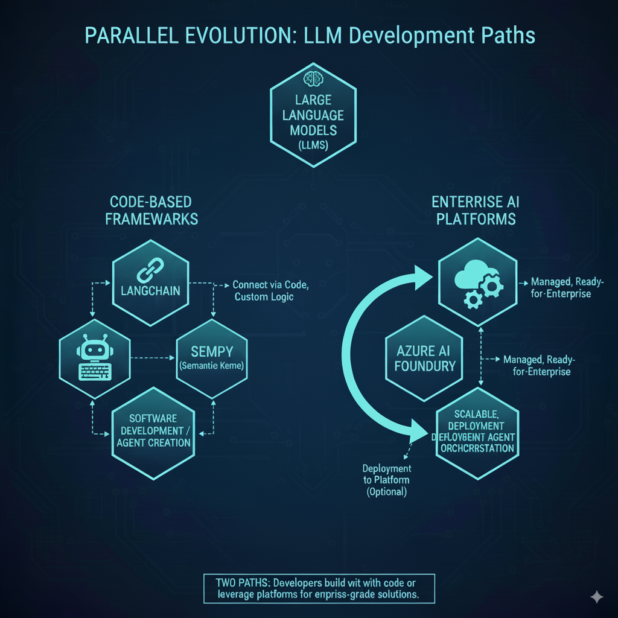

Slide 27
Linking a function to an Assistant/Agent is too complex

Slide 28
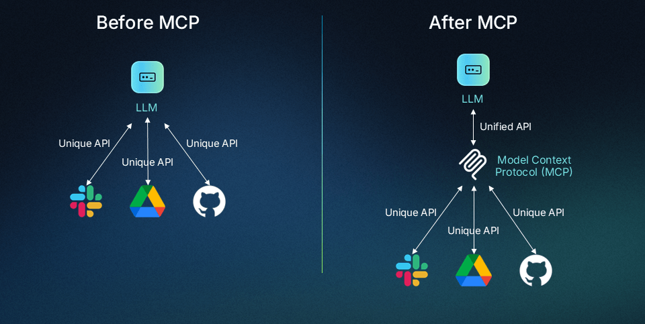
MCP: Model Context Protocol

Slide 29
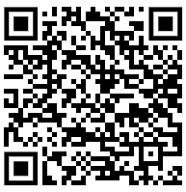
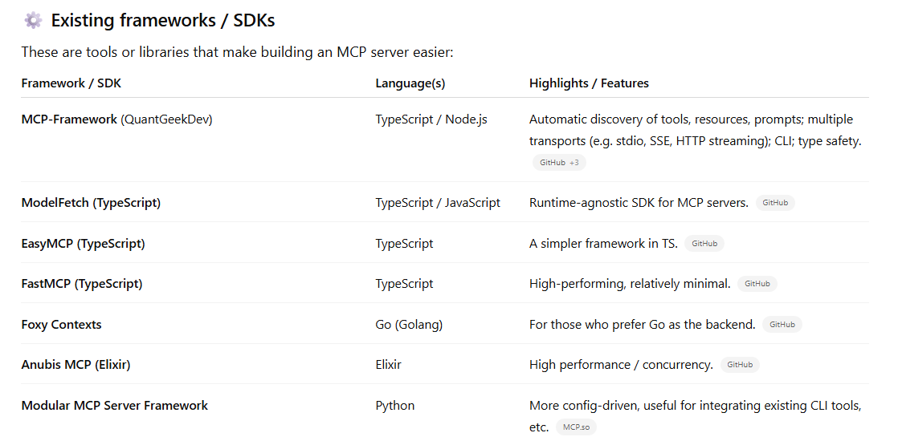
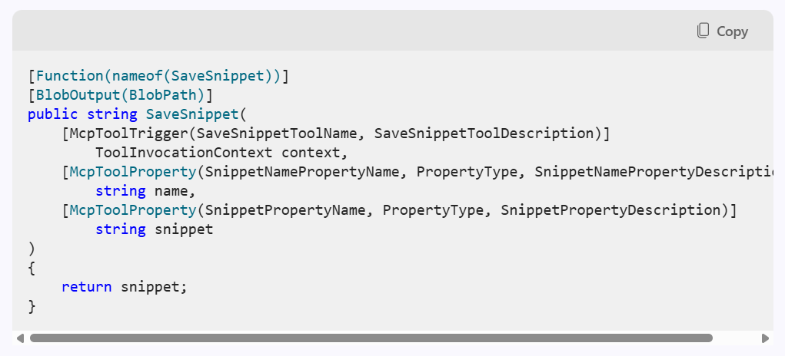
Building a MCP Server

Slide 30
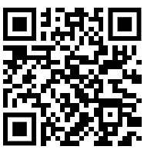
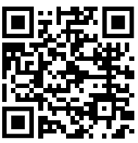
Testing the MCP Server
MCP Inspector
Install the Published Container in Azure Container Instance
Configure CORS
Uses APIFY

Slide 31
MCP Demo

Slide 32
And so on....
Responsible AI
A2A
A2P
Copilot for Citizen Developers

Slide 33
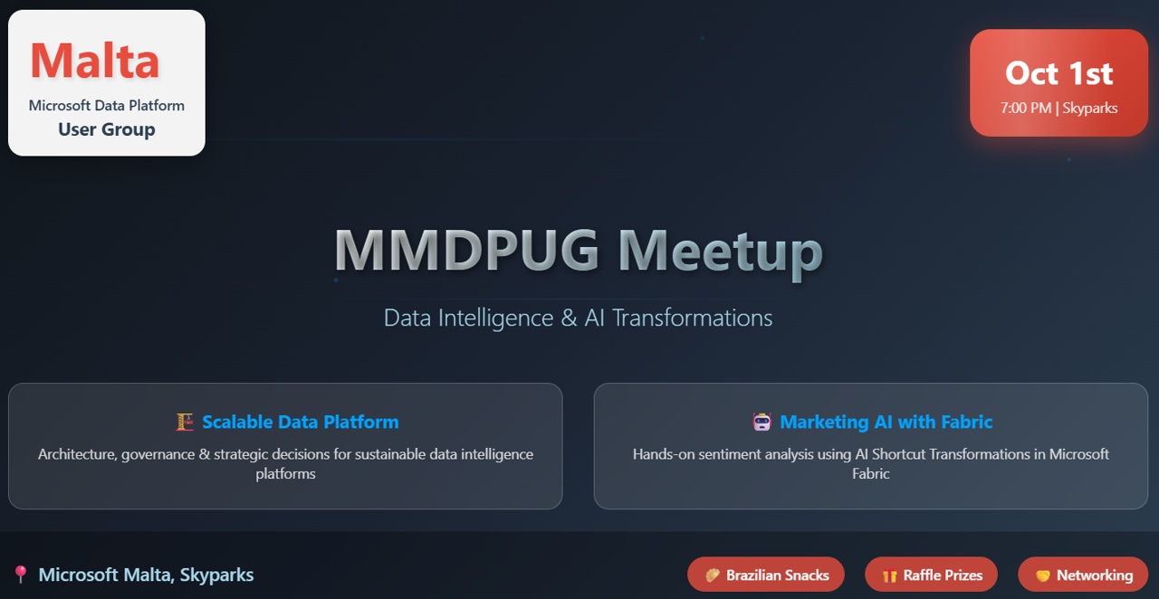
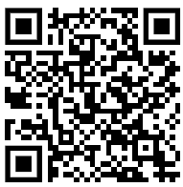

Slide 34
Dennes Torres Data Platform MVP (Alumni)
Dtower Software
https://dtowersoftware.com
Trainer
MCT, Azure Solutions Architect, Azure Data Engineer and Azure DevOps Engineer
Malta Data Platform UG Leader
Malta
MMDPUG
https://www.facebook.com/MMDPUG
http://dennestorres.com
Dennes.Torres
@Dennes
https://br.linkedin.com/in/dennestorres
dennes@bufaloinfo.com.br
http://youtube.com/c/dennestorres

